Slide 1
Instrument & Software
Xu Dong

Slide 2
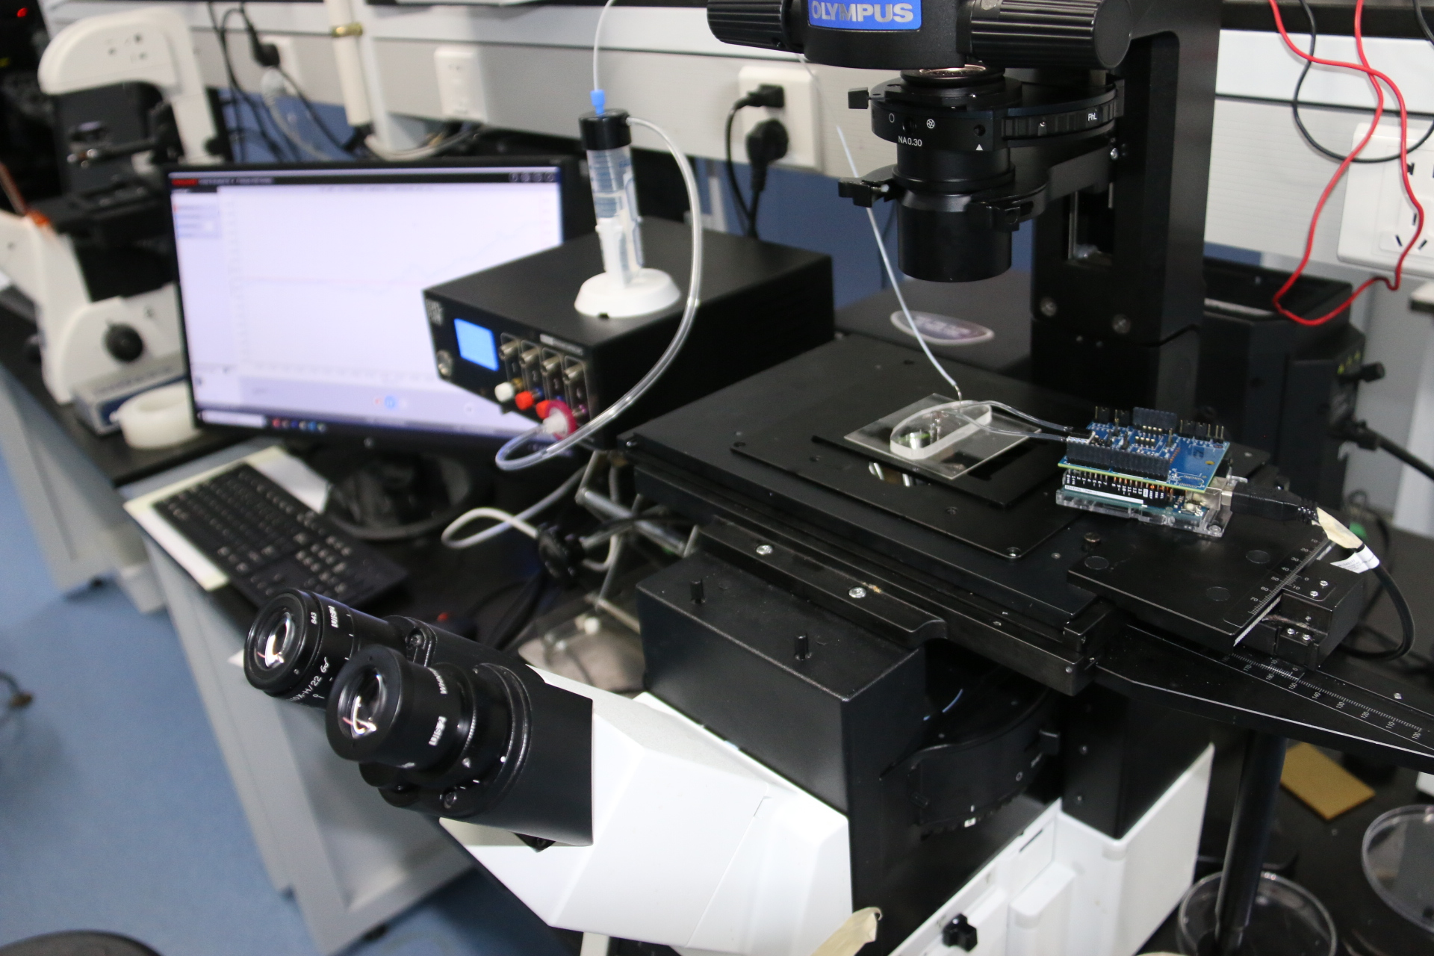
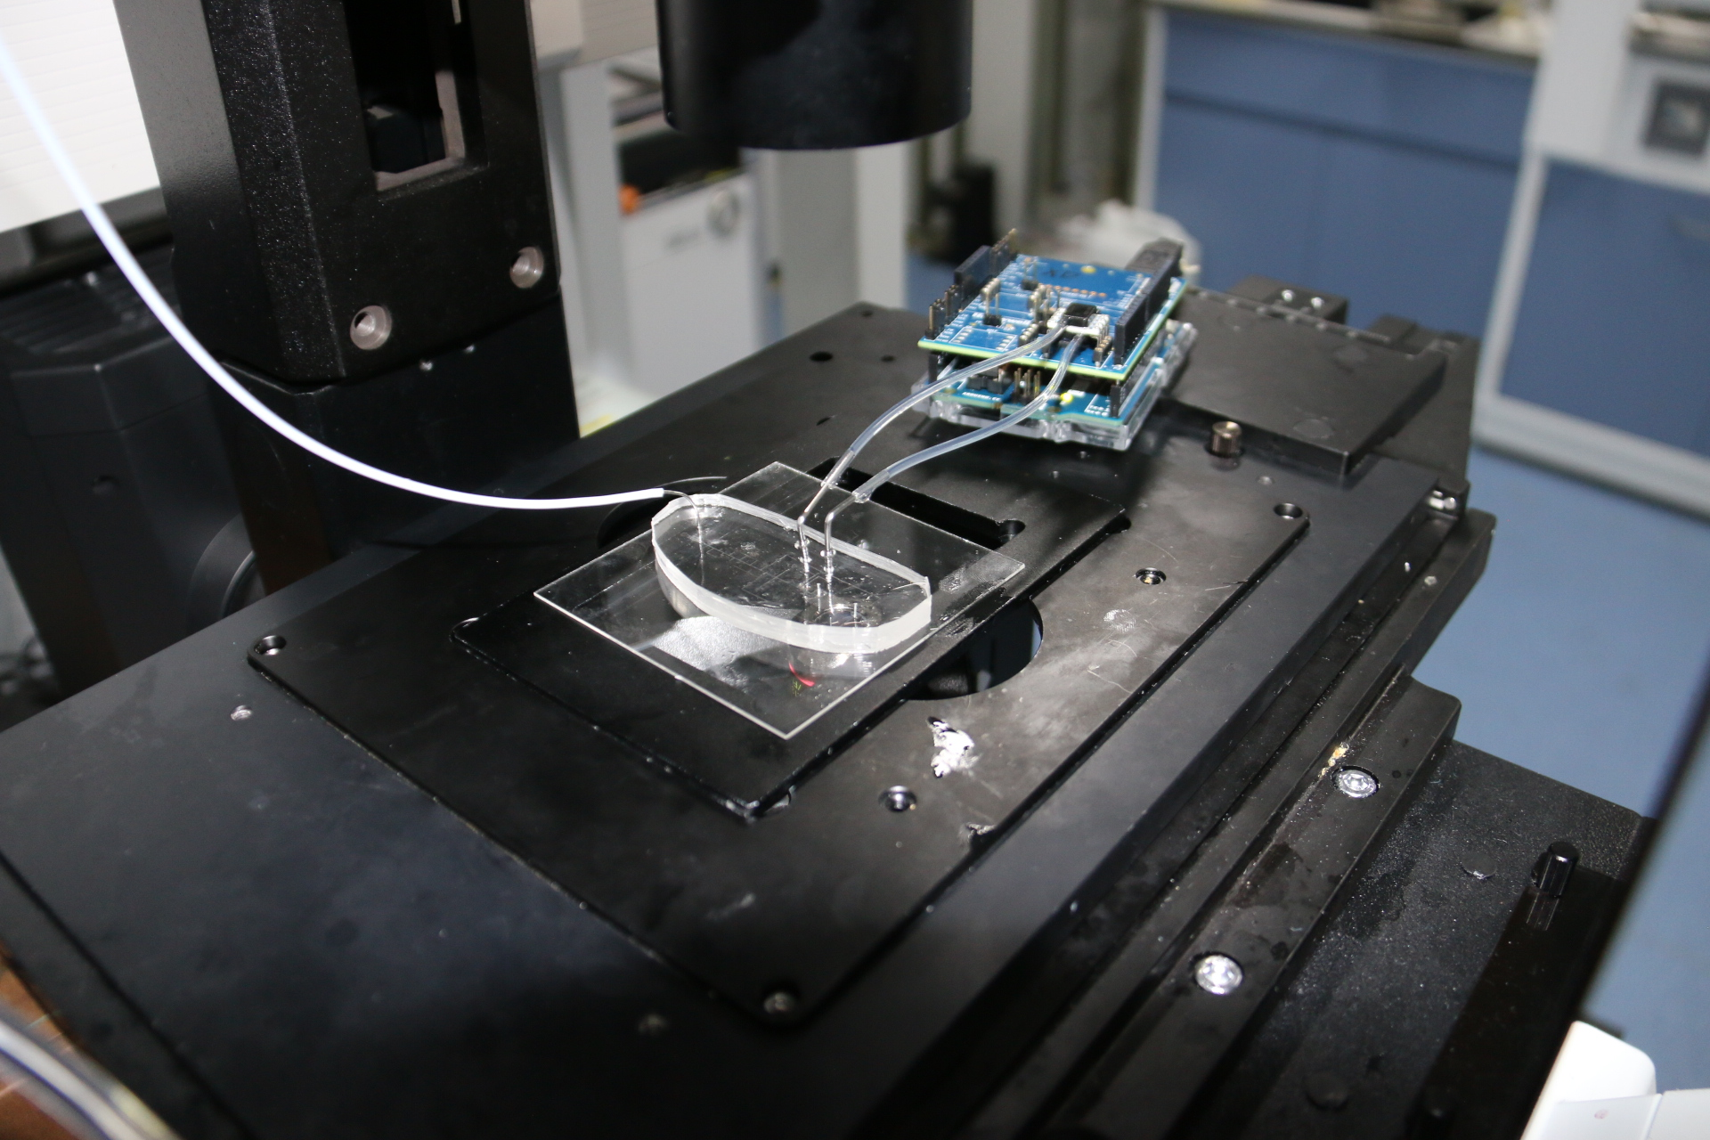
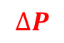
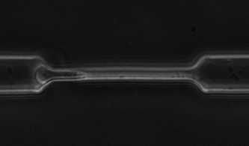
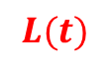
Instrument
OB1
Arduino uno r3
$∆P$
Inlet
Pressure sensor
Microfluidic chip
$L\left(t\right)$

Slide 3
Instrument
Instrument | Brand | Model | Software | URL
Pressure controller | Elveflow | OB1 MK3+ | ESI | https://www.elveflow.com/microfluidic-products/microfluidics-flow-control-systems/ob1-pressure-controller/
Pressure sensor | Honeywell | HSCDRRN010ND6A3 | Sensor Evaluation Kit | https://www.mouser.cn/Sensors/Pressure-Sensors/_/N-6g7qc?P=1z0jo75
Microscope | Olympus | IX 73 | Micro-Manager | https://www.pooher.cn/product/Olympus_IX73.html
CCD camera | Hamamatsu | C11440-36U | Micro-Manager | http://hamamatsu.com.cn/product/17549.html
Arduino | 七星虫 | Uno Rev3 | Sensor Evaluation Kit | https://detail.tmall.com/item.htm?id=22375863328&spm=a1z09.2.0.0.4cc02e8d8ArWav&_u=t1v34nfs02b9

Slide 4
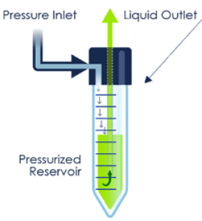
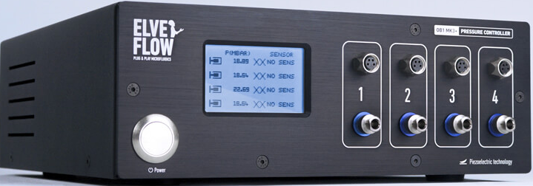
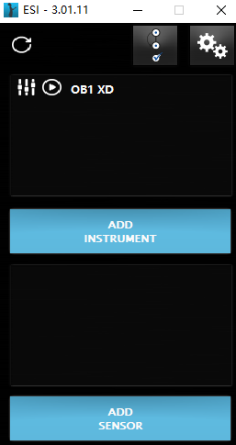
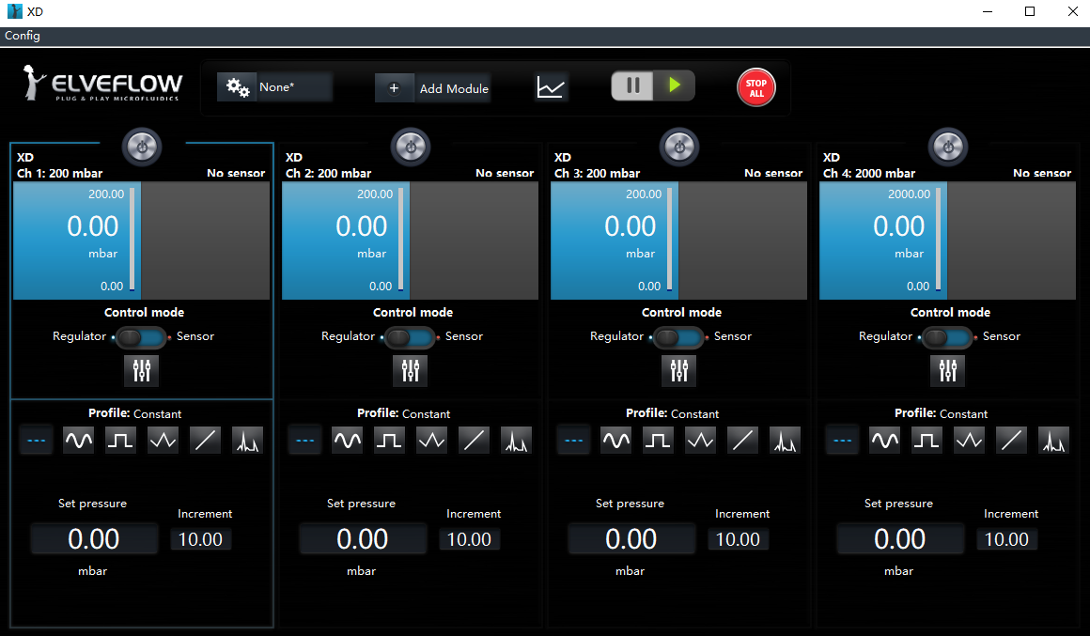
Software: ESI

Slide 5
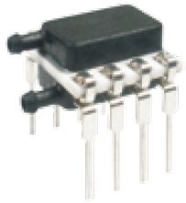
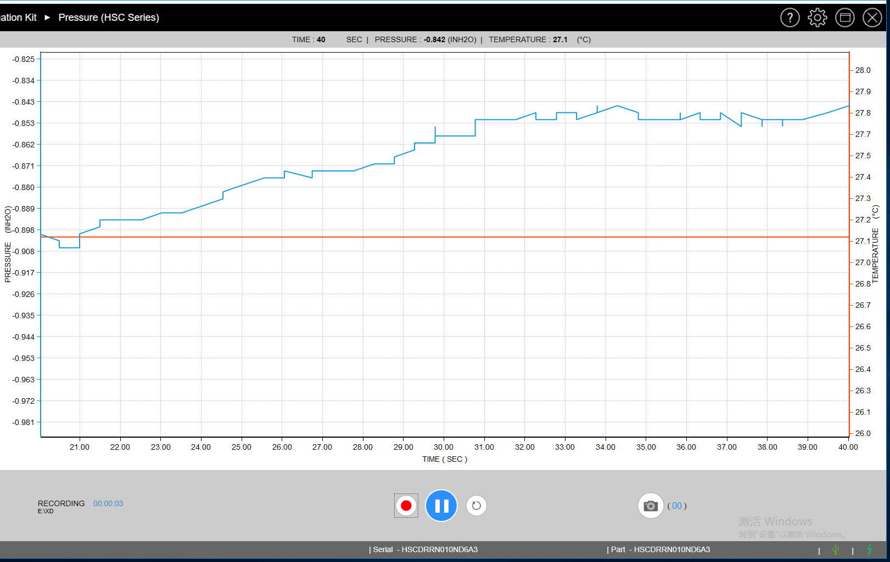
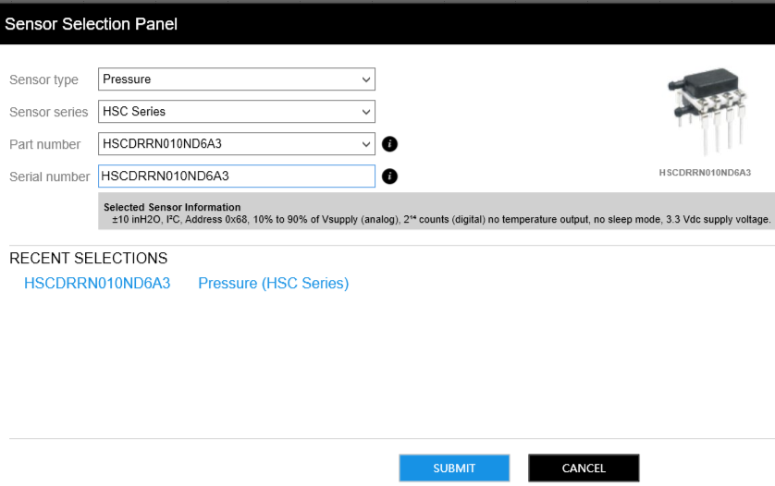
Software: Sensor Evaluation Kit

Slide 6
Thank you!

